Slide 1
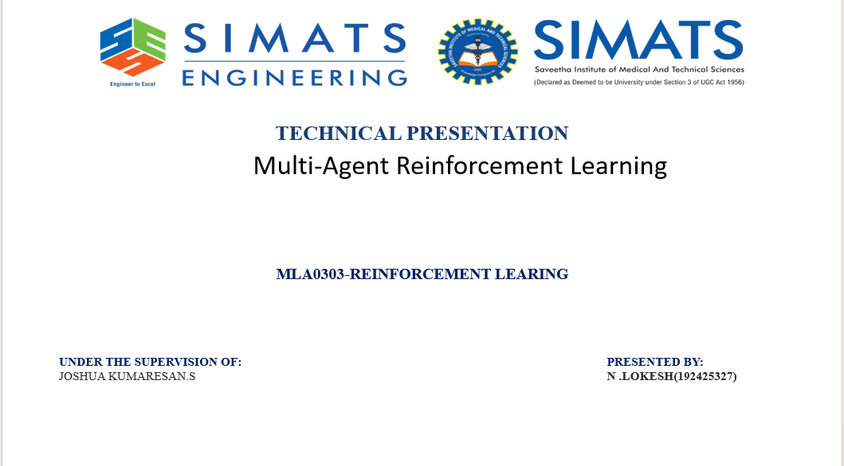
Dr.DUMPALA PRASANTH

Slide 2
INTRODUCTION
What is Multi-Agent Reinforcement Learning?
Multi-Agent Reinforcement Learning (MARL) extends classical Reinforcement Learning to settings where multiple autonomous agents learn and act within a shared environment simultaneously.
A1
A2
A3
Each agent perceives (partial) state and chooses its own actions
Agents may cooperate, compete, or exhibit mixed behavior
The environment becomes non-stationary from any single agent's view, since all agents adapt together
SHARED ENVIRONMENT

Slide 3
COMPARISON
Single-Agent RL vs Multi-Agent RL
SINGLE-AGENT RL
MULTI-AGENT RL
One agent, one policy to optimize
Environment is stationary given a fixed policy
Well-understood convergence guarantees (e.g. Q-learning)
Reward attributed directly to the single actor
Multiple agents, each learning its own policy
Environment is non-stationary — other agents keep changing
Convergence is harder; equilibrium concepts replace optimality
Credit assignment across agents is a core challenge

Slide 4
FOUNDATIONS
Formal Framework: The Markov Game
MARL problems are formalized as a Stochastic (Markov) Game — a tuple that generalizes the single-agent MDP to N interacting agents.
G = ( N , S , { Aᵢ } , T , { Rᵢ } , γ )
N
Set of agents (i = 1 ... N) acting in the environment
S
Shared state space describing the full environment
Aᵢ
Action space available to agent i; joint action A = A₁×...×Aₙ
T
Transition function T(s' | s, a₁,...,aₙ) — depends on the joint action
Rᵢ
Individual reward function for agent i (may differ per agent)
γ
Discount factor applied to future rewards

Slide 5
CORE DIFFICULTIES
Key Challenges in MARL
N
C
S
P
Non-Stationarity
Credit Assignment
Scalability
Partial Observability
As every agent updates its policy, the environment looks different at each step from any one agent's perspective.
When a team reward is shared, isolating each agent's individual contribution to the outcome is difficult.
The joint action space grows exponentially with the number of agents, making exact methods intractable.
Agents typically see only a local view of the state, not the full global picture.

Slide 6
CLASSIFICATION
Types of Multi-Agent Settings
Cooperative
Competitive
Mixed (General-Sum)
Agents share a common goal and a joint (or aligned) reward — e.g. a robot swarm completing a task together.
Agents have opposing objectives; one agent's gain is another's loss, as in zero-sum games.
Agents partially cooperate and partially compete, similar to real-world multi-party interactions.
EXAMPLES
EXAMPLES
EXAMPLES
MADDPG, QMIX, VDN
Self-play, Minimax-Q
COMA, Nash-Q

Slide 7
TRAINING PARADIGM — CTDE
Centralized Training, Decentralized Execution
The dominant paradigm in modern MARL: agents are trained with access to global information, but act using only local observations once deployed.
CENTRALIZED CRITIC (Training Time)
Sees global state + all agents' actions to guide learning
Agent 1
Local Policy π₁
Agent 2
Local Policy π₂
Agent 3
Local Policy π₃
Agent 4
Local Policy π₄
At execution time each agent acts independently using only its own local observation.

Slide 8
ALGORITHM LANDSCAPE
Popular MARL Algorithms
Algorithm | Category | Key Idea
MADDPG | Cooperative / Mixed | Centralized critic per agent with decentralized actor networks
QMIX | Cooperative | Mixes per-agent Q-values via a monotonic network for joint action-value
VDN | Cooperative | Decomposes team Q-value as a simple sum of individual agent values
COMA | Cooperative | Counterfactual baseline isolates each agent's true contribution to the reward
MAPPO | Cooperative / General | Multi-agent extension of PPO with a centralized value function

Slide 9
ENABLING TEAMWORK
Communication & Coordination
Beyond acting on observations, many MARL approaches let agents exchange information to coordinate behavior more effectively.
1
Explicit Messaging
Agents send learned or structured messages to teammates (e.g. CommNet, RIAL/DIAL) before acting.
2
Attention Mechanisms
Agents learn to selectively attend to the most relevant teammates' states (e.g. ATOC, TarMAC).
3
Emergent Communication
Communication protocols arise naturally from the training objective rather than being hand-designed.
4
Implicit Coordination
Agents coordinate purely through observed behavior, without any direct message passing.

Slide 10
WHERE MARL IS USED
Real-World Applications
1
2
3
Robotic Swarms
Autonomous Driving
Game AI
Coordinated warehouse robots and drone fleets performing joint tasks
Fleets of vehicles negotiating traffic, lane changes, and intersections
Team-based strategy games such as StarCraft II and Dota 2
4
5
6
Traffic Signal Control
Resource Allocation
Multi-Robot Exploration
Networked intersections that jointly optimize city-wide traffic flow
Distributed control of power grids and wireless network resources
Teams of robots mapping unknown environments cooperatively

Slide 11
FUTURE DIRECTIONS
Open Challenges & Research Frontiers
1
Scaling learning and communication to hundreds or thousands of agents
2
Building theoretical guarantees for convergence and equilibrium in general-sum games
3
Improving sample efficiency, since multi-agent training requires far more experience than single-agent RL
4
Ensuring safety, robustness, and fairness when agents are deployed among humans
5
Generalizing trained policies to unseen team compositions and opponents

Slide 12
SUMMARY
Conclusion
Multi-Agent Reinforcement Learning brings reinforcement learning to environments shared by many decision-makers, unlocking coordination and competition at scale.
Foundation
Challenge
Solution Trend
Impact
Modeled formally as a Markov (stochastic) game with N interacting agents
Non-stationarity, credit assignment, and scalability remain the central difficulties
Centralized Training, Decentralized Execution (CTDE) dominates current practice
Already powering robotics, autonomous driving, game AI, and smart infrastructure

Slide 13
References
Littman, M. L. (1994). Markov games as a framework for multi-agent reinforcement learning. ICML.
Lowe, R. et al. (2017). Multi-Agent Actor-Critic for Mixed Cooperative-Competitive Environments (MADDPG). NeurIPS.
Rashid, T. et al. (2018). QMIX: Monotonic Value Function Factorisation for Deep Multi-Agent RL. ICML.
Foerster, J. et al. (2018). Counterfactual Multi-Agent Policy Gradients (COMA). AAAI.
Yu, C. et al. (2022). The Surprising Effectiveness of PPO in Cooperative Multi-Agent Games (MAPPO). NeurIPS.
Zhang, K., Yang, Z., & Basar, T. (2021). Multi-Agent Reinforcement Learning: A Selective Overview of Theories and Algorithms.

